Slide 1
Data Mining: Concepts and Techniques (3rd ed.) — Chapter 12 —
Jiawei Han, Micheline Kamber, and Jian Pei
University of Illinois at Urbana-Champaign &
Simon Fraser University
©2011 Han, Kamber & Pei. All rights reserved.
1
Notes:
1

Slide 2
Chapter 12. Outlier Analysis
Outlier and Outlier Analysis
Outlier Detection Methods

Slide 3
What Are Outliers?
Outlier: A data object that deviates significantly from the normal objects as if it were generated by a different mechanism
Ex.: Unusual credit card purchase, sports: Michael Jordon, Wayne Gretzky, ...
Outliers are different from the noise data
Noise is random error or variance in a measured variable
Noise should be removed before outlier detection
Outliers are interesting: It violates the mechanism that generates the normal data.
Outlier detection vs. novelty detection (new trends): early stage, outlier; but later merged into the model
Applications:
Credit card fraud detection
Telecom fraud detection
Customer segmentation
Medical analysis

Slide 4
Types of Outliers (I)
Three kinds: global, contextual and collective outliers
Global outlier (or point anomaly)
Object is O_{g} if it significantly deviates from the rest of the data set
Ex. Intrusion detection in computer networks
Issue: Find an appropriate measurement of deviation
Contextual outlier (or conditional outlier)
Object is O_{c} if it deviates significantly based on a selected context
Ex. 28º F in Urbana (USA): outlier? (depending on summer or winter?)
Attributes of data objects should be divided into two groups
Contextual attributes: defines the context, e.g., time & location
Behavioral attributes: characteristics of the object, used in outlier evaluation, e.g., temperature, humidity and pressure.
Can be viewed as a generalization of local outliers—whose density significantly deviates from its local area
Issue: How to define or formulate meaningful context? Simple method can use group-bys, it may be ineffective due to insufficient data/noise. Other general method can be proximity measure.
Global Outlier
4

Slide 5
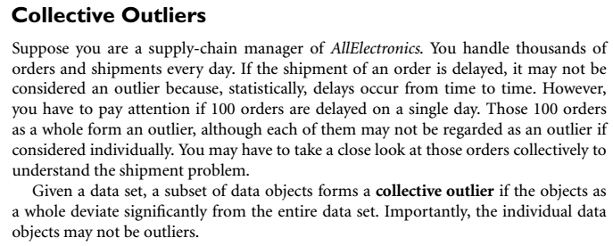
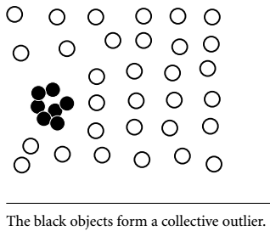
Collective Outlier

Slide 6
Types of Outliers (II)
Collective Outliers
A subset of data objects collectively deviate significantly from the whole data set, even if the individual data objects may not be outliers
Applications: E.g., intrusion detection:
When a number of computers keep sending denial-of-service packages to each other
Collective Outlier
Detection of collective outliers
Consider not only behavior of individual objects, but also that of groups of objects
Need to have the background knowledge on the relationship among data objects, such as a distance or similarity measure on objects.
A data set may have multiple types of outlier
One object may belong to more than one type of outlier
6

Slide 7
Challenges of Outlier Detection
Modeling normal objects and outliers properly
Hard to enumerate all possible normal behaviors in an application
The border between normal and outlier objects is often a gray area
some outlier detection methods assign to each object in the input data set a label of either “normal” or “outlier,” other methods assign to each object a score measuring the “outlier-ness” of the object.
Application-specific outlier detection
Choice of distance measure among objects and the model of relationship among objects are often application-dependent
E.g., clinic data: a small deviation could be an outlier; while in marketing analysis, larger fluctuations
7

Slide 8
Challenges of Outlier Detection…
3. Handling noise in outlier detection
Noise may be present as deviations in attribute values or even as missing values.
Low data quality and the presence of noise bring a huge challenge to outlier detection.
Noise may distort the normal objects and blur the distinction between normal objects and outliers. It may help hide outliers and reduce the effectiveness of outlier detection.
A noise can be detected as outlier by detection methods
4. Understandability
Understand why these are outliers: Justification of the detection. E.g a statistical method can be used to
Specify the degree of an outlier: the unlikelihood of the object being generated by a normal mechanism
8

Slide 9
Chapter 12. Outlier Analysis
Outlier and Outlier Analysis
Outlier Detection Methods
9
Notes:
9

Slide 10
Outlier Detection I: Supervised Methods
Two ways to categorize outlier detection methods:
Based on whether user-labeled examples of outliers can be obtained:
Supervised,
semi-supervised vs.
unsupervised methods
Based on assumptions about normal data and outliers:
Statistical,
proximity-based, and
clustering-based methods
10
Notes:
Synthetic Minority over-sampling Technique(SMOTE)

Slide 11
Outlier Detection(1) I: Supervised Methods
Outlier Detection I: Supervised Methods
Modeling outlier detection as a classification problem
Samples examined by domain experts used for training & testing
Methods for Learning a classifier for outlier detection effectively:
Model normal objects & report those not matching the model as outliers, or
Model outliers and treat those not matching the model as normal
Challenges
Imbalanced classes, i.e., outliers are rare: Boost the outlier class and make up some artificial outliers ( like use SMOTE)
Catch as many outliers as possible, i.e., recall(TP/P) is more important than accuracy[(TP+TN)/(P+N)] (i.e., not mislabeling normal objects as outliers)
Class imbalance dataset link http://sci2s.ugr.es/keel/imbalanced.php
11
Notes:
Synthetic Minority over-sampling Technique(SMOTE)
Class imbalance datasets link http://sci2s.ugr.es/keel/imbalanced.php

Slide 12
Outlier Detection(1) II: Unsupervised Methods See book pno.550
Assume the normal objects are somewhat ``clustered'‘ into multiple groups, each having some distinct features
An outlier is expected to be far away from any groups of normal objects
Weakness: Cannot detect collective outlier effectively
Normal objects may not share any strong patterns, but the collective outliers may share high similarity in a small area
Ex. In some intrusion or virus detection, normal activities are diverse
Unsupervised methods may have a high false positive rate but still miss many real outliers.
Supervised methods can be more effective, e.g., identify attacking some key resources
Many clustering methods can be adapted for unsupervised methods
Find clusters, then outliers: not belonging to any cluster,
Problem 1: Hard to distinguish noise from outliers
Problem 2: Costly since first clustering: but far less outliers than normal objects
Newer methods: tackle outliers directly
12

Slide 13
Outlier Detection(1) III: Semi-Supervised Methods
Situation: In many applications, the number of labeled data is often small: Labels could be on outliers only, normal objects only, or both
Semi-supervised outlier detection: Regarded as applications of semi-supervised learning
If some labeled normal objects are available
Use the labeled examples and the proximate unlabeled objects to train a model for normal objects
Those not fitting the model of normal objects are detected as outliers
If only some labeled outliers are available, a small number of labeled outliers many not cover the possible outliers well
To improve the quality of outlier detection, one can get help from models for normal objects learned from unsupervised methods
13

Slide 14
Outlier Detection(2) (1): Statistical Methods
Statistical methods (also known as model-based methods) assume that the normal data follow some statistical model (a stochastic model)
The data not following the model are outliers.
Example (right figure): First use Gaussian distribution to model the normal data
For each object y in region R, estimate g_{D}(y), the probability of y fits the Gaussian distribution
If g_{D}(y) is very low, y is unlikely generated by the Gaussian model, thus an outlier
Effectiveness of statistical methods: highly depends on whether the assumption of statistical model holds in the real data
There are rich alternatives to use various statistical models
E.g., parametric vs. non-parametric
14

Slide 15
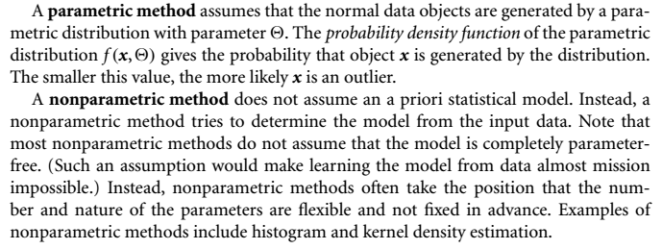

Slide 16
Outlier Detection (2): Proximity-Based Methods
An object is an outlier if the nearest neighbors of the object are far away, i.e., the proximity of the object is significantly deviates from the proximity of most of the other objects in the same data set
Example (right figure): Model the proximity of an object using its 3 nearest neighbors
Objects in region R are substantially different from other objects in the data set.
Thus the objects in R are outliers
The effectiveness of proximity-based methods highly relies on the proximity measure.
In some applications, proximity or distance measures cannot be obtained easily.
Often have a difficulty in finding a group of outliers which stay close to each other
Two major types of proximity-based outlier detection
Distance-based vs. density-based
16

Slide 17
Outlier Detection (3): Clustering-Based Methods
Normal data belong to large and dense clusters, whereas outliers belong to small or sparse clusters, or do not belong to any clusters
Example (right figure): two clusters
All points not in R form a large cluster
The two points in R form a tiny cluster, thus are outliers
Since there are many clustering methods, there are many clustering-based outlier detection methods as well
Clustering is expensive: straightforward adaption of a clustering method for outlier detection can be costly and does not scale up well for large data sets
17

